Slide 1
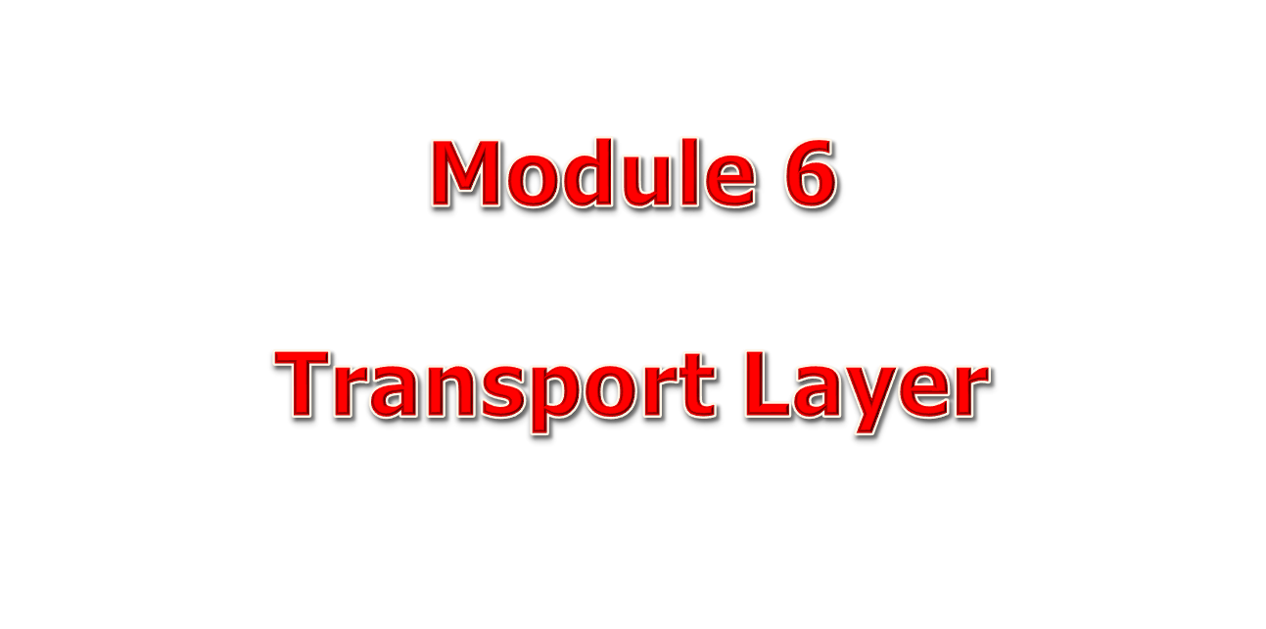
20.<number>

Slide 2
23-1 PROCESS-TO-PROCESS DELIVERY
The transport layer is responsible for process-to-process delivery—the delivery of a packet, part of a message, from one process to another. Two processes communicate in a client/server relationship, as we will see later.
Topics discussed in this section:
Client/Server Paradigm
Multiplexing and Demultiplexing
Connectionless Versus Connection-Oriented Service
Reliable Versus Unreliable
Three Protocols
23.<number>

Slide 3

Note
The transport layer is responsible for process-to-process delivery.
23.<number>

Slide 4

Figure 23.1 Types of data deliveries
23.<number>

Slide 5

Figure 23.4 IANA ranges
Ephemeral
23.<number>

Slide 6
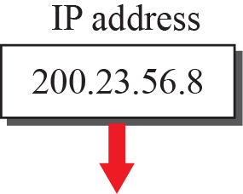
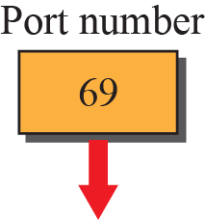
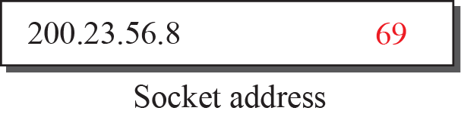
Figure 23.6: Socket address
23.<number>
Notes:
23.#

Slide 7

Figure 23.6 Multiplexing and demultiplexing
23.<number>

Slide 8

Figure 23.2 Port numbers
23.<number>

Slide 9
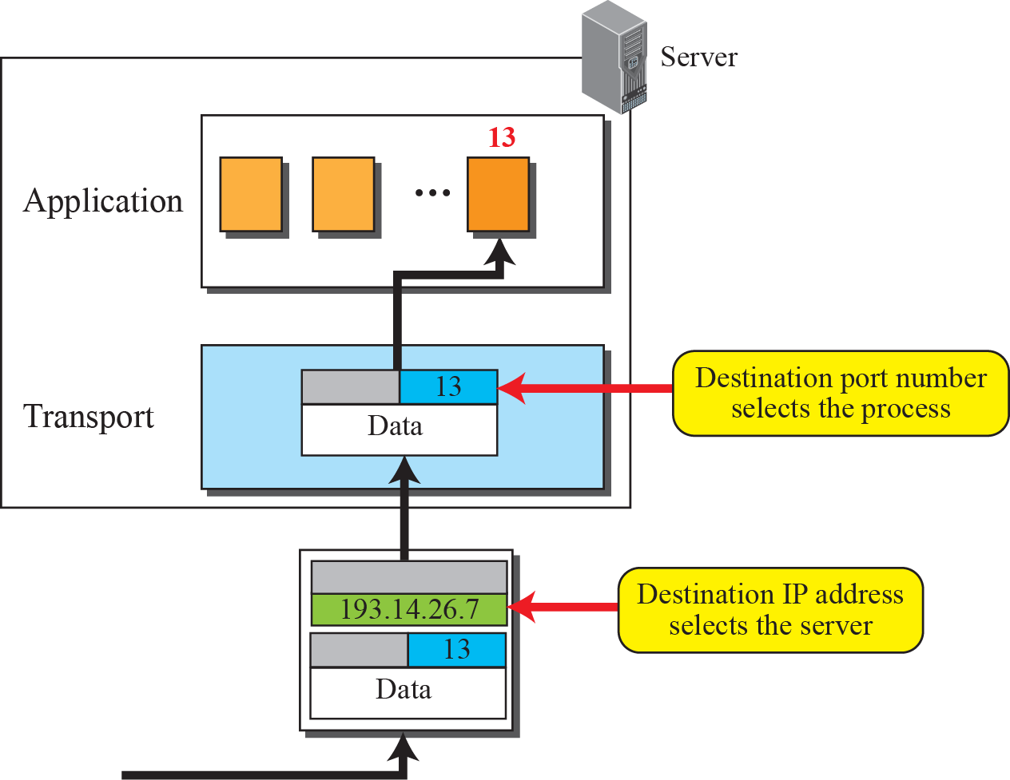
Figure 23.4: IP addresses versus port numbers
23.<number>
Notes:
23.#

Slide 10
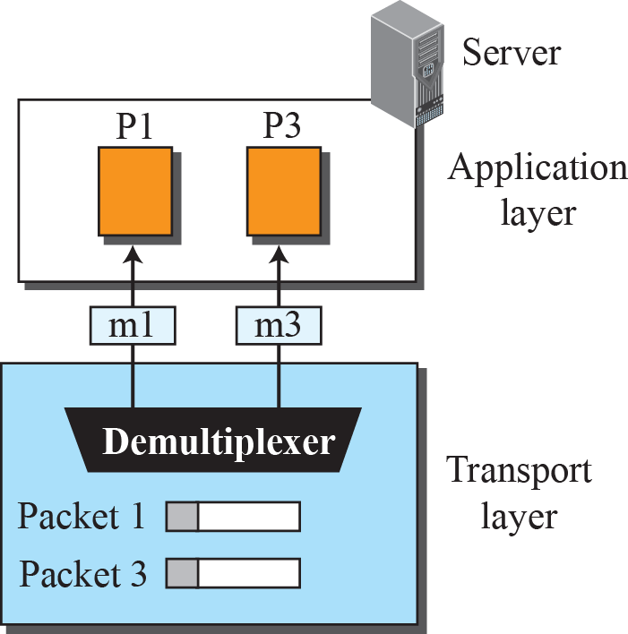
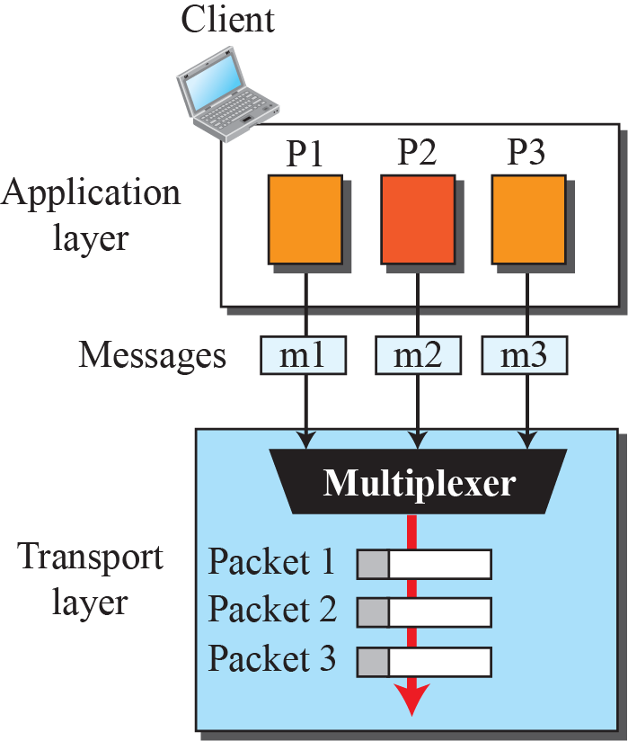
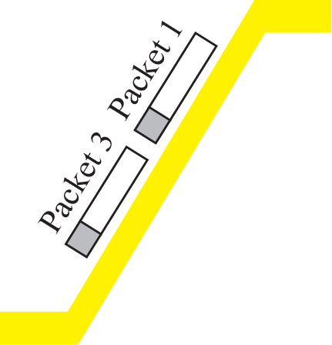
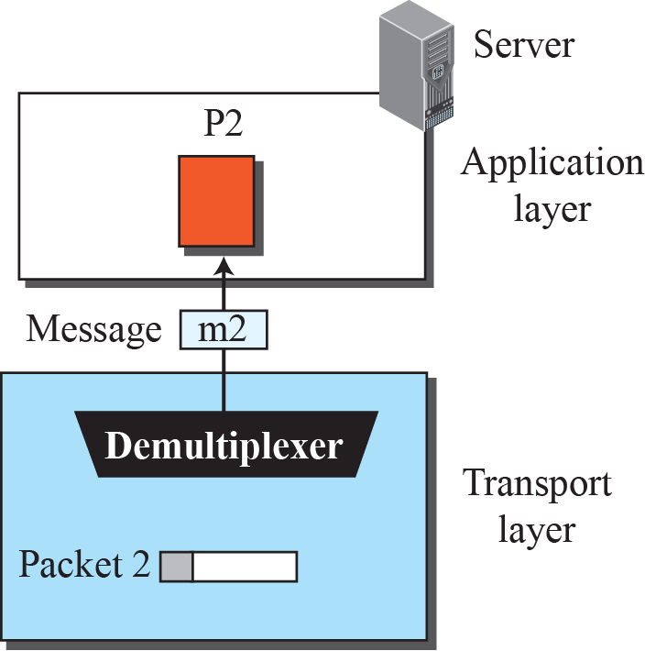
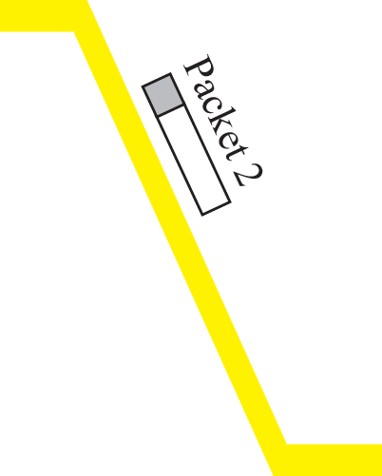
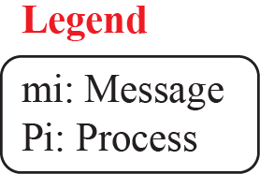
Figure 23.8: Multiplexing and demultiplexing
23.<number>
Notes:
23.#

Slide 11
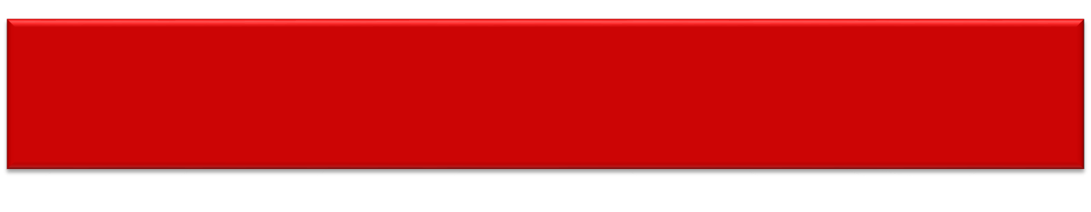
Connectionless vs Connection Oriented Service
Connectionless
  Packets sent from one party to another with no connection establishment/release
  Packets not numbered
  May be delayed/out of order/lost
  No Acknowledgement
  Ex : UDP
Connection-oriented
  Connection established between sender/receiver
  Data transferred
  Connection Released
  Ex : TCP/SCTP

Slide 12
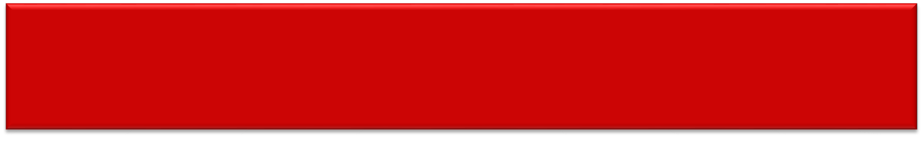
Reliable vs Unreliable
Depending on Application Layer Program
  Reliability criteria
    Use Reliable Transport Layer protocol
    Flow Control/Error Control
    Slower/Complex Service
    TCP/SCTP are connection oriented & reliable
  Relax Reliability criteria
    For Faster Service
    Nature of service does not demand Flow/Error Control
    UDP is connectionless & reliable

Slide 13
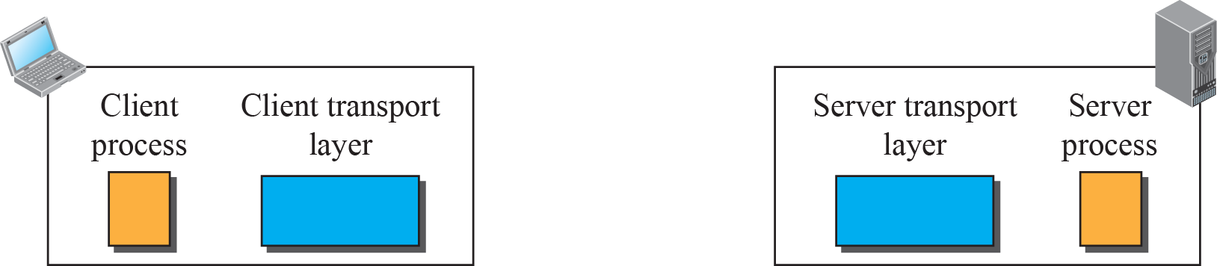




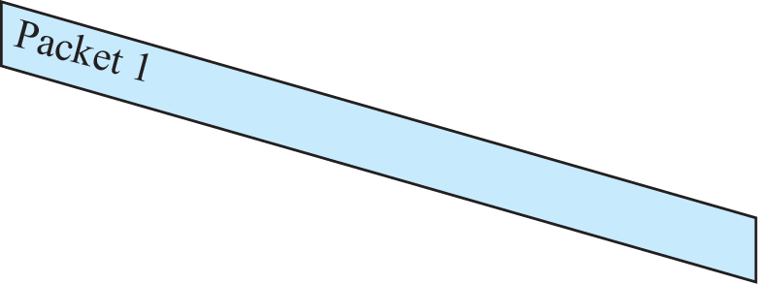


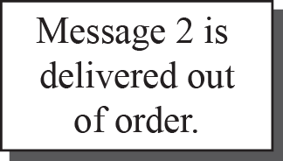
Figure 23.14: Connectionless service
23.<number>
Notes:
23.#

Slide 14
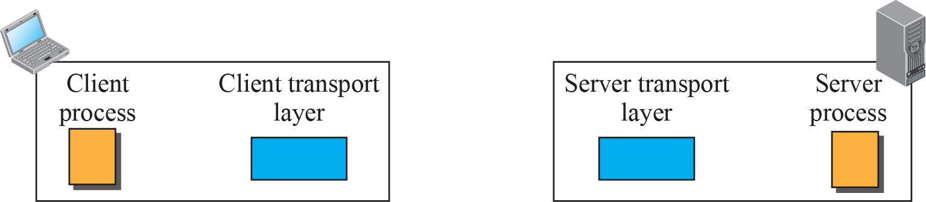
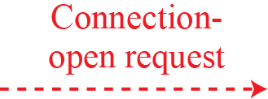






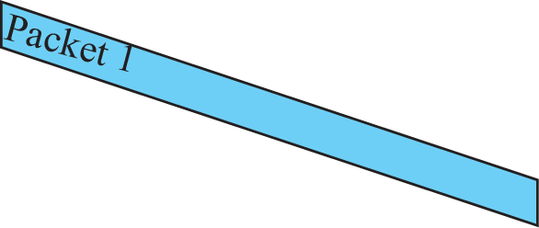



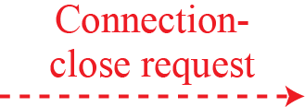



Figure 23.15: Connection-oriented service
23.<number>
Notes:
23.#

Slide 15

Figure 23.7 Error control
Network Layer in Internet is unreliable
Implement at transport layer
23.<number>

Slide 16

Figure 23.8 Position of UDP, TCP, and SCTP in TCP/IP suite
23.<number>

Slide 17
23-2 USER DATAGRAM PROTOCOL (UDP)
The User Datagram Protocol (UDP) is called a connectionless, unreliable transport protocol. It does not add anything to the services of IP except to provide process-to-process communication instead of host-to-host communication.
Topics discussed in this section:
Well-Known Ports for UDP
User Datagram
Checksum
UDP Operation
Use of UDP
23.<number>

Slide 18
User Datagram Protocol
Very Simple
Minimum Overhead
Process with small messages can use
Does not care much about reliability
Process cannot send stream of data to UDP and expect to chop into datagrams
Each User datagram may travel on different path
No relationship between datagrams, not numbered
No flow control, No window mechanism
Receiver may overflow with incoming messages
UDP provides only checksum. Receiver silently discards if error in checksum
Sender does know if message is lost/duplicated

Slide 19
Example 24. 3
A client-server application such as DNS uses the services of UDP because a client needs to send a short request to a server and to receive a quick response from it.
The request and response can each fit in one user datagram.
Since only one message is exchanged in each direction, the connectionless feature is not an issue;
the client or server does not worry that messages are delivered out of order.
24.<number>

Slide 20
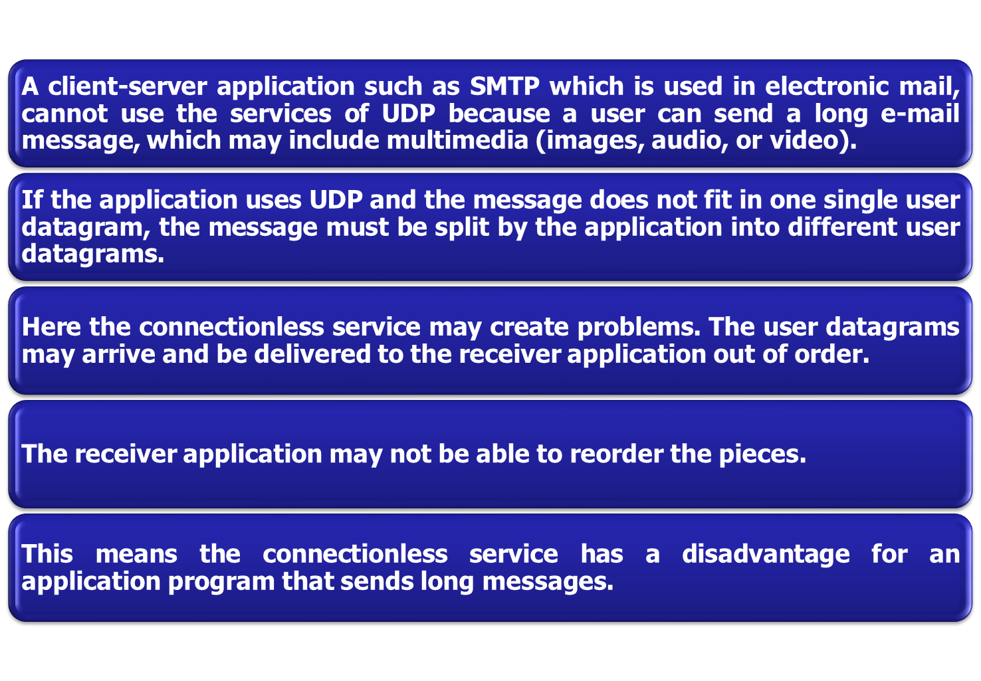
Example 24.4

Slide 21
Example 25.5
Assume we are downloading a very large text file from the Internet.
We definitely need to use a transport layer that provides reliable service.
We don’t want part of the file to be missing or corrupted when we open the file.
The delay created between the deliveries of the parts is not an overriding concern for us;
Wait until the whole file is composed before looking at it. In this case, UDP is not a suitable transport layer.
24.<number>

Slide 22
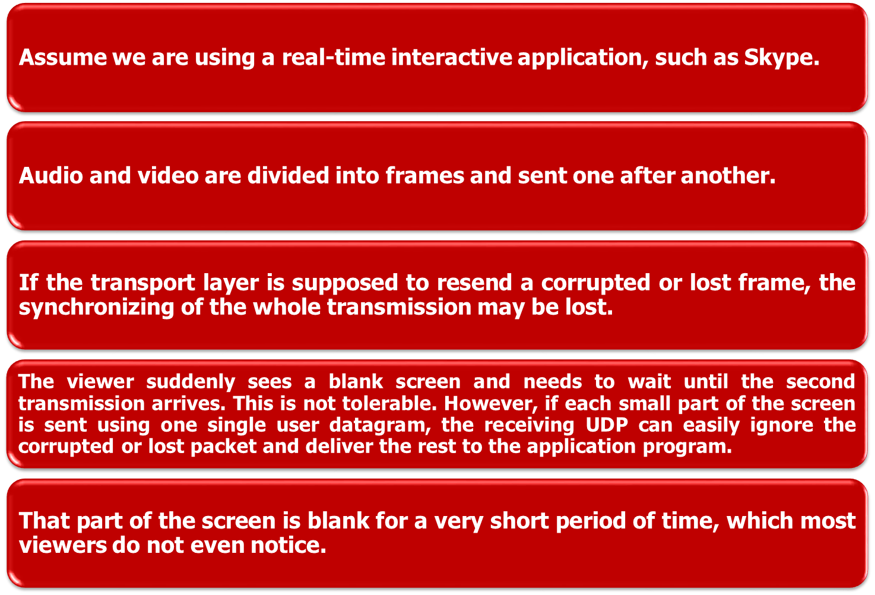
Example 25.6
24.<number>

Slide 23


Table 23.1 Well-known ports used with UDP
23.<number>

Slide 24

Figure 23.9 User datagram format
No relationship between user datagrams
No numbering,No flow & Error Control, No ack
Processes sending short messages uses UDP
23.<number>

Slide 25

Figure 23.12 Queues in UDP
23.<number>

Slide 26
23-3 TCP
TCP is a connection-oriented protocol; it creates a virtual connection between two TCPs to send data. In addition, TCP uses flow and error control mechanisms at the transport level.
Topics discussed in this section:
TCP Services
TCP Features
Segment
A TCP Connection
Flow Control
Error Control
23.<number>

Slide 27

Table 23.2 Well-known ports used by TCP
23.<number>

Slide 28
Transmission Control Protocol
Create a Virtual Connection (not physical) to send data
Stream Oriented Protocol
Each Message from Process = 1 User Datagram = 1 IP Datagram (UDP)
TCP = Deliver data as STREAM of BYTES
Producer & Consumer of Stream of bytes
Sending/ Receiving Buffers for storage
Reading/Writing data may not occur at same speed.
Keep track of sent bytes in buffer until receives an acknowledgment
Recycle the buffer & made available for use by sending process.
Receiver process, once bytes read , recycle & added to pool of available chambers
TCP groups number of bytes = Segment + Header = IP Datagram
Segments may be received out of order/lost/corrupted/resent

Slide 29

Figure 23.13 Stream delivery
23.<number>

Slide 30

Figure 23.14 Sending and receiving buffers
23.<number>

Slide 31

Figure 23.15 TCP segments
Segments created from bytes in buffers
Segments not necessarily of same size
23.<number>

Slide 32
TCP FEATURES
Offers Full-Duplex reliable service.
  Each TCP has sending/receiving buffers and segments move in both directions
Numbering System
  Segment Header ( 2 field – Sequence Number, Acknowledgement Number)
  Byte number & Not Segment Number
  Numbering of Bytes independent in each direction
  Numbering is used for Flow & Error Control
  TCP generates random number between 0 and 2³²-1 for 1st byte number. (Connection Establishment phase – ISN)
  Sequence number of each segment is 1st byte number in that segment.

Slide 33
Note
The bytes of data being transferred in each connection are numbered by TCP.
The numbering starts with a randomly generated number.
23.<number>

Slide 34

Example 23.3
The following shows the sequence number for each segment:
Imagine a TCP connection is transferring a file of 5000 bytes. Each Segment carries 1000 bytes
23.<number>

Slide 35
Note
The value in the sequence number field of a segment defines the
number of the first data byte
contained in that segment.
23.<number>

Slide 36
Note
The value of the acknowledgment field in a segment defines
the number of the next byte a party expects to receive.
The acknowledgment number is cumulative.(last byte num + 1)
23.<number>

Slide 37

Figure 23.16 TCP segment format
23.<number>

Slide 38
TCP Header
Port Numbers
A socket identifies a connection endpoint
  IP address + port
A connection specified by a socket pair
Well-known ports
  FTP 20
  Telnet 23
  DNS 53
  HTTP 80
Sequence Number
Byte count
First byte in segment
32 bits long
0 ≤ SN ≤ 2³²-1
Initial sequence number selected during connection setup

Slide 39
TCP Header
Acknowledgement Number
SN of next byte expected by receiver
Acknowledges that all prior bytes in stream have been received correctly
Valid if ACK flag is set
Header length
4 bits
Length of header in multiples of 32-bit words
Minimum header length is 20 bytes
Maximum header length is 60 bytes

Slide 40
TCP Header
Window Size (16 bits to advertise window size)
  Maximum Size of window is 65535 bytes (16 bits)
  Referred as RWND ( Receiver window) – determined by receiver
  Sender must obey the dictation of receiver
Checksum
  16 bit checksum – mandatory

Slide 41
TCP Connection
Virtual Path between Source/Destination
TCP uses services of IP to deliver individual segments to receiver , but it controls connection itself
Segment is lost/corrupted – retransmitted
IP is unaware of this retransmission, out of order segments (TCP holds)
3 phases
  1) Connection Establishment
  2) Data Transfer
  3) Connection Termination

Slide 42
Phase 1 : Connection Establishment
3-way Handshaking process
Each Party initialize communication and get approval from other party before data transfer
Server Program tells TCP – ready to accept connection ( Passive open ) – cannot make connection on its own
Client Program issues request for Active Open (tells TCP of that particular server)

Slide 43

Phase 1 : Connection establishment using three-way handshaking
Segment 1 (SYN –Synchronization of sequence numbers)
ACK if no data, does not consume sequence numbers)
23.<number>

Slide 44
Note
A SYN segment cannot carry data, but it consumes one sequence number.
23.<number>

Slide 45
Note
A SYN + ACK segment cannot
carry data, but does consume one
sequence number.
23.<number>

Slide 46
Note
An ACK segment, if carrying no data, consumes no sequence number.
23.<number>

Slide 47

Phase 2 : Data Transfer
Figure 23.19 Data transfer- bidirectional
23.<number>

Slide 48
Phase 3 : Connection Termination
3-way Handshaking
  Normal Situation case
  Close Command from Client Process
  FIN segment (FIN flag set)
  FIN segment can also include last segment of data also
  Server TCP informs the process after receiving FIN
  FIN + ACK to announce closing in other direction

Slide 49

Figure 23.20 Connection termination using three-way handshaking
23.<number>

Slide 50
Note
The FIN segment consumes one sequence number if it does
not carry data.
23.<number>

Slide 51
Note
The FIN + ACK segment consumes
one sequence number if it
does not carry data.
23.<number>

Slide 52

Sliding window (Byte oriented) for TCP Flow Control
Variable size, out of order, no NAK (Like Selective Repeat)
Send all bytes in window without worrying about ACK
Sender obeys command from receiver
23.<number>

Slide 53
Note
A sliding window is used to make transmission more efficient as well as
to control the flow of data so that the destination does not become
overwhelmed with data.
TCP sliding windows are byte-oriented.
23.<number>

Slide 54
Window Size
min (rwnd, cwnd)
rwnd – Receiver Advertised Window Size
  value advertised by opp end in ACK segment
cwnd – Congestion Window Size
  value determined by network to avoid congestion
  If network cannot deliver as fast as they are created by sender, needs to slow down

Slide 55
Example 23.4
What is the value of the receiver window (rwnd) for host A if the receiver, host B, has a buffer size of 5000 bytes and 1000 bytes of received and unprocessed data?
Solution
The value of rwnd = 5000 − 1000 = 4000. Host B can receive only 4000 bytes of data before overflowing its buffer. Host B advertises this value in its next segment to A.
23.<number>

Slide 56
Example 23.5
What is the size of the window for host A if the value of rwnd is 3000 bytes and the value of cwnd is 3500 bytes?
Solution
The size of the window is the smaller of rwnd and cwnd, which is 3000 bytes.
23.<number>

Slide 57
Example 23.6
Unrealistic example of a sliding window.
The sender has sent bytes up to 202. We assume that cwnd is 20 (in reality this value is thousands of bytes).
The receiver has sent an acknowledgment number of 200 with an rwnd of 9 bytes (in reality this value is thousands of bytes).
The size of the sender window is the minimum of rwnd and cwnd, or 9 bytes.
Bytes 200 to 202 are sent, but not acknowledged. Bytes 203 to 208 can be sent without worrying about acknowledgment. Bytes 209 and above cannot be sent.
23.<number>

Slide 58

Figure 23.23 Example 23.6
23.<number>

Slide 59
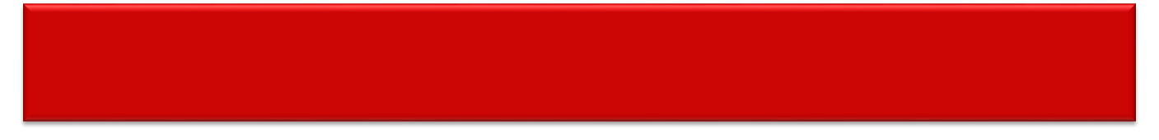
Error Control using Checksum, ACK, Timeout
Note
ACK segments do not consume sequence numbers and are not acknowledged.
23.<number>

Slide 60
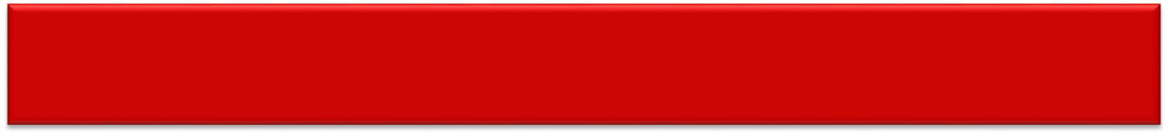

Segment is lost/corrupted/delayed -retransmit
Note
In modern implementations, a retransmission occurs if the retransmission timer expires or three duplicate ACK segments have arrived.
Retransmission time-out (RTO) timer – RTT
Fast Retransmission – before RTO
23.<number>

Slide 61
Note
Data may arrive out of order and be temporarily stored by the receiving TCP,
but TCP guarantees that no out-of-order segment is delivered to the process.
23.<number>

Slide 62

Figure 23.24 Normal operation
Delayed to
see more
segment arrive
23.<number>

Slide 63

Lost segment – somewhere in network, corrupted (discard by receiver)
Immediately ACK
23.<number>

Slide 64
Note
The receiver TCP delivers only ordered data to the process.
23.<number>

Slide 65

Figure 23.26 Fast retransmission
Timer for
segment 3
not matured yet
23.<number>

Slide 66
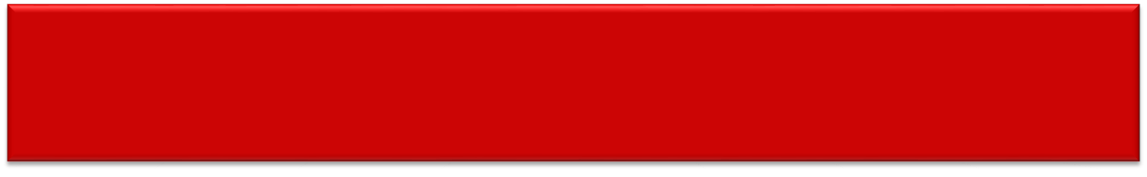

Network Congestion
Congestion
  occurs when bandwidth is insufficient and network data traffic exceeds capacity.
  results from applications sending more data than the network devices (e.g., routers and switches) can accommodate,
  thus causing the buffers on such devices to fill up and possibly overflow.
Congestion control is primarily concerned with controlling the traffic to reduce overload on the network

Slide 67
Congestion Policy
3 phases
Slow-Start Phase
  Sender starts with very slow rate of transmission
  Increases rapidly till threshold
Congestion Avoidance
  When Threshold reached, Reduce Data rate to avoid congestion
Congestion Detection
  Sender goes back to Slow Start / Congestion Avoidance phase depending on how congestion is detected

Slide 68
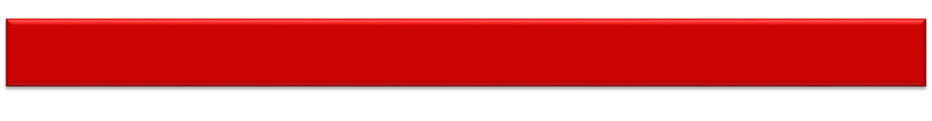

Transmission Control Protocol (TCP)
Slow start, exponential increase
Assume 1) rwnd > cwnd 2) segment ack individually
cwnd = 1 MSS
Size of cwnd in
terms of rounds
24.<number>
Note : Segment numbers for Simplification

Slide 69
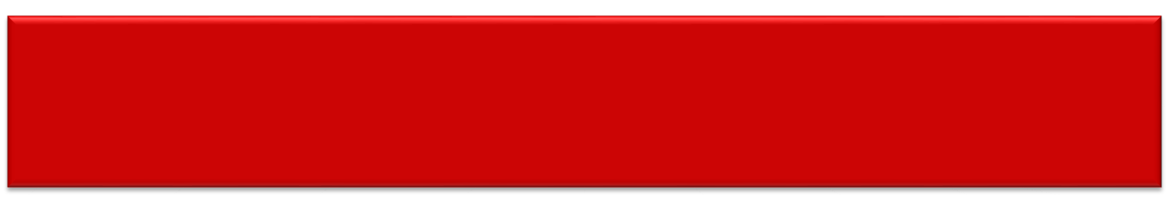
Note
In the slow-start algorithm, the size of the congestion window increases exponentially until it reaches a threshold.
ssthresh (Slow Start Threshold)
Window Size in bytes reaches ssthresh,
Go to next phase
24.<number>

Slide 70

Congestion avoidance, additive increase
24.<number>

Slide 71
Note
In the congestion avoidance algorithm, the size of the congestion window increases additively until
congestion is detected.
24.<number>

Slide 72
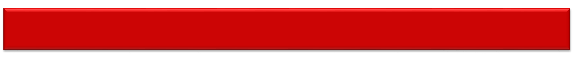
Congestion Detection : Multiplicative Decrease
An implementation reacts to congestion detection in one of the following ways:
❏ If detection is by time-out, a new slow
start phase starts. (TCP reacts strongly)
ssthreshold = (current cwnd)/2
cwnd = 1 MSS
❏ If detection is by three ACKs, a new
congestion avoidance phase starts.
(Fast Retransmission/Fast Recovery - Weaker
possibility of congestion)
cwnd = ssthreshold (or ssthreshold + 3 segment size)
24.<number>

Slide 73

Congestion example
24.<number>

